Slide 1
Digital Electronics Crash course – day 1
21-AUG-2018
Abhimanyu Arora
Koh Yi Min Jason

Slide 2
Table of content
Day 1 1) Binary/Hexadecimal/BCD
2) Signed/Unsigned number
3) Binary and Hexadecimal addition
4) Logic gates circuits and Boolean Algebra
5) Implementing/simplifying logics gates
6) SOP (Sum-Over-Product), POS (Product-Over-Sum) and K-map
Day 2
7) Clock Signal and flip-flops (SR, JK, T, D)
8) D flip-flop state machine
9) Multiplexer, Comparator and De-Multiplexer
10) Encoder, Decoder, decade counter, up/down synchronous counter and ripper counters
11) 7-Segment display, 7-Segment display decade counter and BCD to 7-segment display driver

Slide 3
Binary/Hexadecimal/BCD

Slide 4
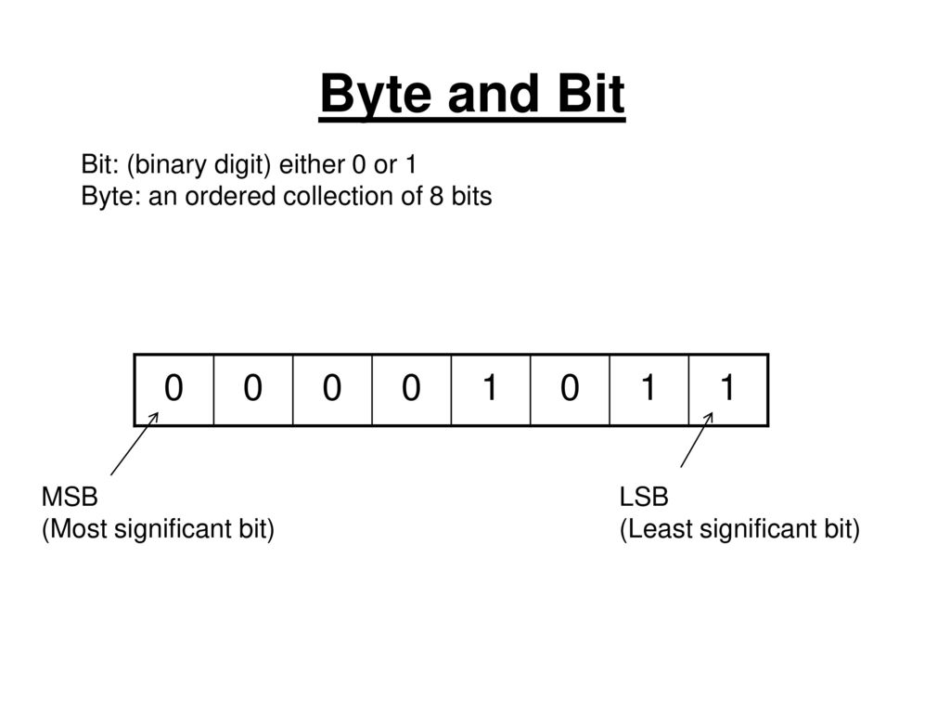
Binary
What is Binary?
In order for computers to perform any logical/arithmetic operation on numbers, it has to be converted to Binary.
Binary is a number system that has a radix (base) of 2.
A binary digit is called a bit and 8 bits is called a byte.
In a binary number, the binary digit at the right end is called the Least Significant bit (LSB) and the binary digit at the left end is called the Most Significant bit (MSB)

Slide 5
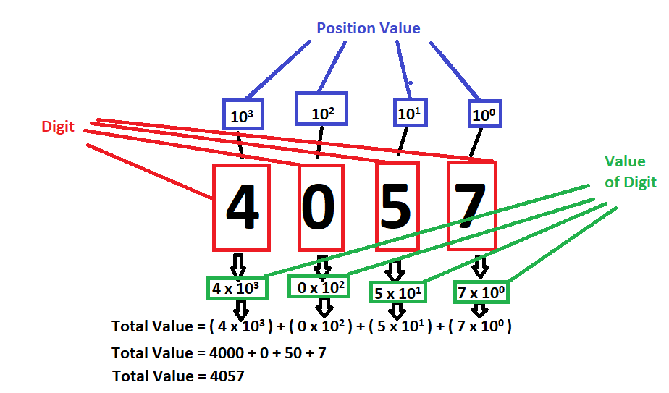
Binary
Decimal number system - In the decimal number system, each Digit (D) has a position value (PV) of 10^{n} where n is the position number - Each Digit (D) has 10 symbols (0, 1, 2, 3, 4, 5, 6, 7, 8, 9) - The Digit at the right end has a position number of 0. It is called the “ones place” - The Value of Digit (VD) is equal to Position Value (PV) multiply by the Digit (D) VD = PV x D
Example: 4057 = VD₃ + VD₂ + VD₁ + VD₀ 4057 = (D x PV)₃ + (D x PV)₂ + (D x PV)₁ + (D x PV)₀ 4057 = (4 x 10³) + (0 x 10²) + (5 x 10¹) + (7 x 10⁰) 4057 = 4057

Slide 6
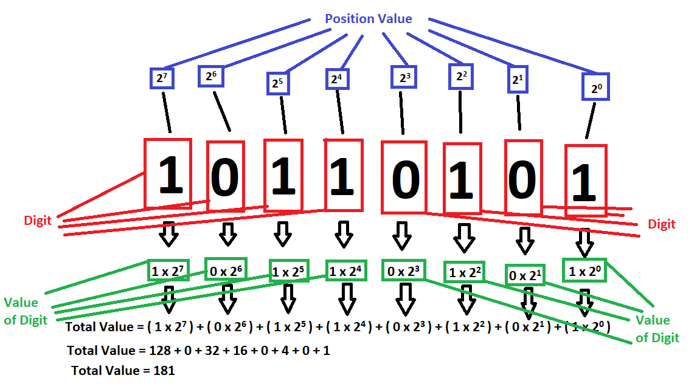
Binary
Binary number system In a Binary number system, each Digit (D) has a position value (PV) of 2^{n} where n is the position number The Digit at the right end has a position number of 0. It is called the “one places”
In a binary number system, each Digit (D) has 2 symbols (0 and 1) The Value of Digit (VD) is equal to Position (PV) Value multiply by the Digit (D) VD = PV x D
Example: 1011 0101 = VD₇ + VD₆ + VD₅ + VD₄ + VD₃ + VD₂ + VD₁ + VD₀ 1011 0101 = (D x PV)₇ + (D x PV)₆ + (D x PV)₅ + (D x PV)₄ + (D x PV)₃ + (D x PV)₂ + (D x PV)₁ + (D x PV)₀ 1011 0101 = (1 x 2⁷) + (0 x 2⁶) + (1 x 2⁵) + (1 x 2⁴) + (0 x 10³) + (1 x 10²) + (5 x 0¹) + (7 x 1⁰) 1011 0101₂ = 1011 0101₂ = 181₁₀

Slide 7
Decimal to Binary
Decimal to Binary (Method #1 - Divided by 2) To convert from Decimal to Binary, we take the decimal number and keep performing a whole number division by 2 till we get 0
The remainders of the quotient will be the binary number. The largest position value is at the bottom
Aesef
Example:1 Convert 114₁₀ to Binary
Answer: 111 0010₂
Operation | Quotient | remainders
114 ÷ 2 | 57 | 0
57 ÷ 2 | 28 | 1
28 ÷ 2 | 14 | 0
14 ÷ 2 | 7 | 0
7 ÷ 2 | 3 | 1
3 ÷ 2 | 1 | 1
1 ÷ 2 | 0 | 1
1 1 1 0 0 1 0

Slide 8
Decimal to Binary
Example:2 Convert 261₁₀ to Binary
Example:3 Convert 199₁₀ to Binary

Slide 9
Decimal to Binary
Decimal to Binary (Method #2 - Tables) Step 1: We draw a table listing the all position values that is smaller than the number Step 2: fills up “1” to the column correspond to the position values till the sums of all position values are equal to the number
Example:1 Convert 114₁₀ to Binary
64 | 32 | 16 | 8 | 4 | 2 | 1
1 | 1 | 1 | 0 | 0 | 1 | 0
1 1 1 0 0 1 0
Answer: 111 0010₂

Slide 10
Decimal to Binary
Example:2 Convert 261₁₀ to Binary using the table method
Example:3 Convert 199₁₀ to Binary using the table method

Slide 11
Binary to Decimal
Binary to Decimal Multiply each digit of the binary with its respective position value and sum all of them
Example:1 Convert 1110 0011₂ to decimal
128 | 64 | 32 | 16 | 8 | 4 | 2 | 1
1 | 1 | 1 | 0 | 0 | 0 | 1 | 1
= (128 x 1) + (64 x 1) + (32 x 1) + (16 x 0) + (8 x 0) + (4 x 0) + (2 x 1) + (1 x 1) = (128 x 1) + (64 x 1) + (32 x 1) + (2 x 1) + (1 x 1)
= 227
Answer: 227₁₀

Slide 12
Binary to Decimal
Example:2 Convert 0001 0001₂ to decimal
Example:3 Convert 1111 1001₂ to decimal

Slide 13
Decimal to Hexadecimal
Decimal to Hexadecimal Similar to convert from Decimal to Binary, we take the decimal number and keep performing a whole number division by 16 till we get 0
The remainders of the quotient will be the binary number. The largest position value is at the bottom
Aesef
Example:1 Convert 124₁₀ to Hexadecimal
Answer: 7C₁₆
Operation | Quotient | Remainders (Decimal | Remainders (HexDecimal)
124 ÷ 16 | 7 | 12 | C
7 ÷ 16 | 0 | 7 | 7
7 C

Slide 14
Decimal to Hexadecimal
Example 2: Convert 493₁₀ to Hexadecimal

Slide 15
Decimal to Hexadecimal
Example 3: Convert 2193₁₀ to Hexadecimal

Slide 16
Hexadecimal to decimal
Hexadecimal to decimal Just like converting binary to decimal, we will multiply each digit of the hexadecimal with its respective position value and sum all of them
Example:1 Convert A3₁₆ to decimal
16¹ = 16 | 16⁰ = 1
A | 3
= (10 x 16) + (3 x 1)
= 163
Answer: 163₁₀

Slide 17
Hexadecimal to decimal
Decimal | Hexadecimal
0 | 0
1 | 1
2 | 2
3 | 3
4 | 4
5 | 5
6 | 6
7 | 7
8 | 8
9 | 9
10 | A
11 | B
12 | C
13 | D
14 | E
15 | F
Example:2 Convert E9B₁₆ to decimal
Example:3 Convert D87F₁₆ to decimal

Slide 18
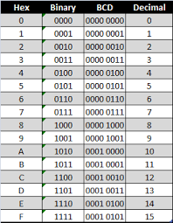
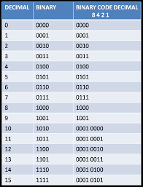
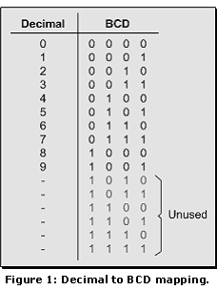
BCD number system
What is BCD
BCD (Binary-coded decimal) is a 4 bit binary number that has a maximum value of 1001₂ or 9 in decimal

Slide 19
BCD number system
Decimal to BCD conversion To convert from decimal to BCD, we take individual digit in a decimal number and convert it to its respective 4 bit binary number
Example:1 Convert 93₁₀ to BCD
9 3
1001
0011
Answer: 1001 0011_{BCD}

Slide 20
BCD number system
Example:2 Convert 421₁₀ to BCD
Example:3 Convert 9281₁₀ to BCD

Slide 21
Binary and Hexadecimal addition

Slide 22
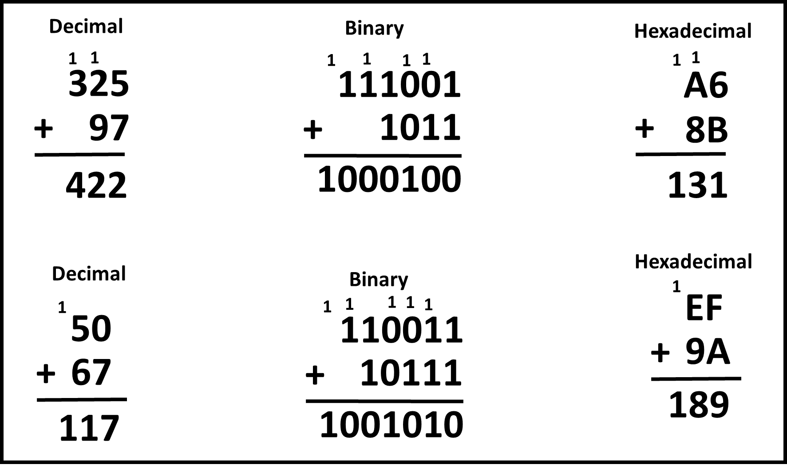
Binary and Hexadecimal addition
Binary and Hexadecimal addition
Just like adding in decimal, we can also add in binary and Hexadecimal

Slide 23
Binary and Hexadecimal addition
Example:1 add 1001111₂ and 1110100₂ together
Example:1 add E93₁₆ and FF₁₆ together
1
1
1
1
1
1
1
1001111
E93
+
1110100
+
FF
11000011
F92

Slide 24
Binary and Hexadecimal addition
Example:2 Add 1110101₂ and 11111₂ together
Example:2 Add AD9₁₆ and E78₁₆ together
Example:3 Add 10111011₂ and 111111₂ together
Example:3 Add FF23₁₆ and DF57₁₆ together

Slide 25
Signed/Unsigned number

Slide 26
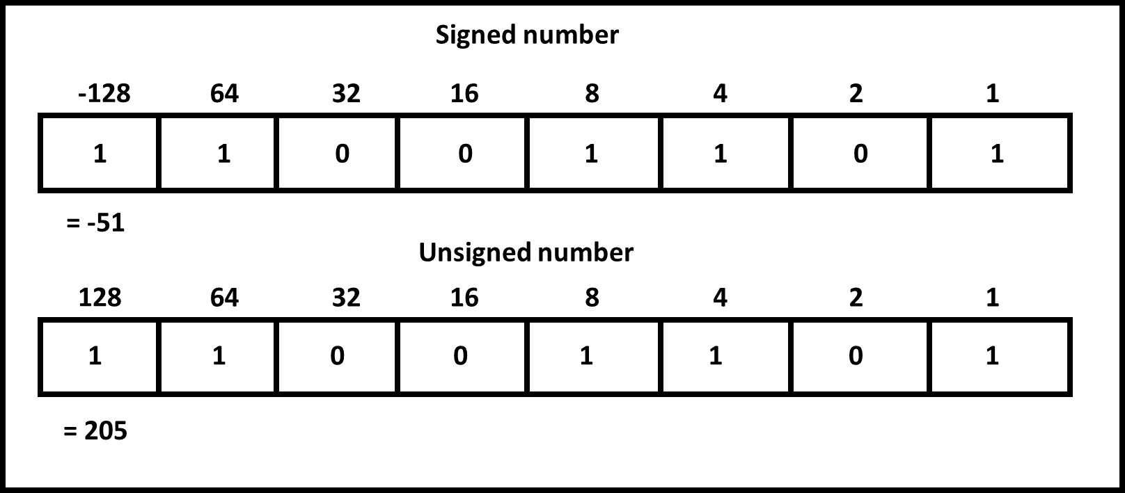
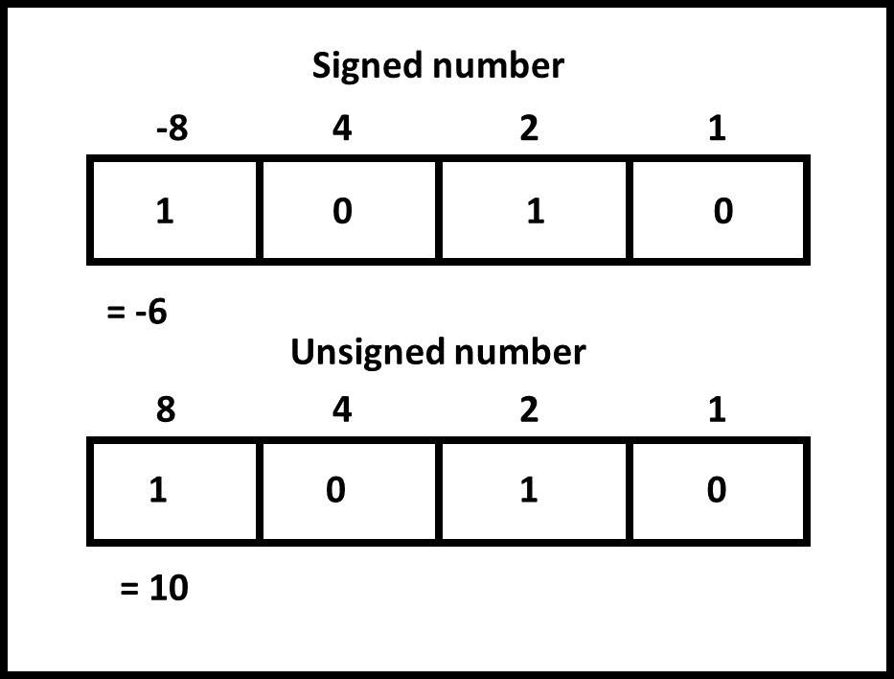
Signed/Unsigned number
What are signed numbers? To represent negative numbers in binary, we need to use signed binary number system
An unsigned binary number system can only represent positive binary numbers We will learn 2’s compliment signed numbering representation, in this number system the Most significant bit has a negative position value of what that digit has in an unsigned number system

Slide 27
Signed/Unsigned number
Converting decimal to signed binary number is different from converting decimal to unsigned binary number
Example:1 Convert -34₁₀ to 2’s compliment signed binary number
Step 3:
Step 1:
Convert the -34₁₀ to unsigned binary number as if you are converting 34₁₀ to binary
Add 1₂ to the inverted value
0 1 1 1 0 1₂
1 0 0 0 1 0₂
+
1₂
Step 2:
Invert all the bits
0 1 1 1 1 0₂
1 0 0 0 1 0₂
Step 4:
0 1 1 1 0 1₂
Add the signed bit to the binary number
Signed bit
1 0 1 1 1 1 0₂
Value from step 3
= 1 0 1 1 1 1 0₂

Slide 28
Signed/Unsigned number
Example:2 Convert -99₁₀ to 2’s compliment signed binary number
Example:3 Convert -212₁₀ to 2’s compliment signed binary number

Slide 29
Logic gates

Slide 30
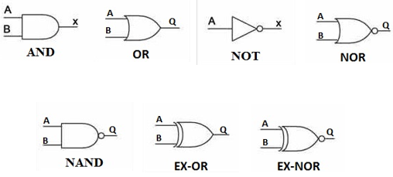
Logics gates
What are logics gates? - Logic gates are electronic devices that implement a Boolean function. Condition in the logic gate’s inputs need to be met in order for the logic gate to output a TRUE.
There are 7 logics gate 1) NOT
2) AND
OR
NAND
NOR
XOR
XNOR

Slide 31


Logics gates
NOT gate
NOT gates has only one input and one output
The NOT gate take the input signal and inverts it
NOT gate symbol
NOT gate Truth Table
NOT gate Boolean expression
Input | Output
A | Q
0 | 1
1 | 0
$$Q= \overline{A}$$

Slide 32


Logics gates
AND gate
AND gates has minimum two inputs and one output. There is no limit to how many inputs an AND gate can have.
All inputs need to be TRUE in order to output a TRUE
NOT gate symbol
AND gate Truth Table
AND gate Boolean expression
Input |  | Output
A | B | Q
0 | 0 | 0
0 | 1 | 0
1 | 0 | 0
1 | 1 | 1
$$Q=AB$$

Slide 33


Logics gates
OR gate
OR gates has minimum two inputs and one output. There is no limit to how many inputs an OR gate can have.
Either one of the inputs need to be TRUE in order to output a TRUE
OR gate symbol
OR gate Truth Table
OR gate Boolean expression
Input |  | Output
A | B | Q
0 | 0 | 0
0 | 1 | 1
1 | 0 | 1
1 | 1 | 1
$$Q=A+B$$

Slide 34


Logics gates
NAND gate
NAND gates has minimum two inputs and one output. There is no limit to how many inputs a NAND gate can have. ALL of the inputs need to be TRUE in order to output a FALSE NAND gates are AND gates with a NOT gate connected to its output
NAND gate symbol
NAND gate Truth Table
NAND gate Boolean expression
Input |  | Output
A | B | Q
0 | 0 | 1
0 | 1 | 1
1 | 0 | 1
1 | 1 | 0
$$Q=\overline{AB}$$

Slide 35


Logics gates
NOR gate
NOR gates has minimum two inputs and one output. There is no limit to how many inputs a NOR gate can have. Either one of the inputs need to be TRUE in order to output a FALSE NOR gates are OR gates with a NOT gate connected to its output
NOR gate symbol
NOR gate Truth Table
NOR gate Boolean expression
Input |  | Output
A | B | Q
0 | 0 | 1
0 | 1 | 0
1 | 0 | 0
1 | 1 | 0
$$Q=\overline{A+B}$$

Slide 36


Logics gates
XOR gate
XOR gates has only two inputs and one output. Both inputs need to be on a different logic level in order to output a TRUE
XOR gate symbol
XOR gate Truth Table
XOR gate Boolean expression
Input |  | Output
A | B | Q
0 | 0 | 0
0 | 1 | 1
1 | 0 | 1
1 | 1 | 0
$$Q=A⊕B$$

Slide 37


Logics gates
XNOR gate
XOR gates has only two inputs and one output. Both inputs need to be same logic level in order to output a TRUE
XNOR gate symbol
XNOR gate Truth Table
XNOR gate Boolean expression
Input |  | Output
A | B | Q
0 | 0 | 1
0 | 1 | 0
1 | 0 | 0
1 | 1 | 1
$$Q=\overline{A⊕B}$$

Slide 38
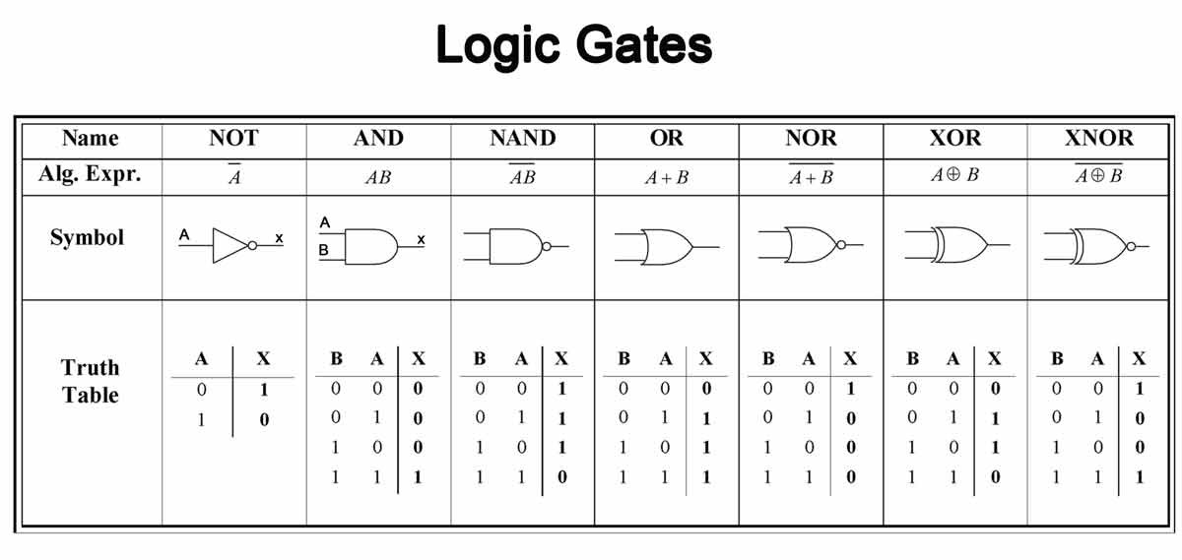
Logics gates

Slide 39
Implementing/simplifying logics gates

Slide 40
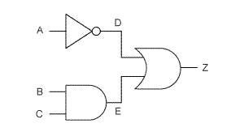
Implementing Logics gate
Logics gate cascaded together to create desire logics outcome For example the picture shows an OR gate inputs are connected to the output of the NOT gate and AND gate. The Boolean expression for the circuit is Z = A’ + BC

Slide 41
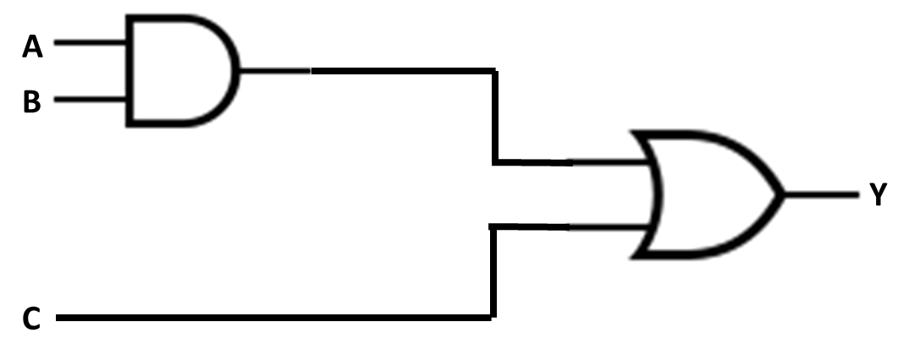
Implementing Logics gate
When given a Boolean expression. we need to know how to draw the logic circuits
Example:1 Implement the following logic Y = AB + C
Answer

Slide 42

Implementing Logics gate
Example:2 Implement the following logic
Example:3 Implement the following logic
$$y=D(\overline{A}B+C)$$
$$y=\left(\left(A+B\right)⊕\left(\overline{C}E+F\right)\right)+G$$

Slide 43

Simplifying Logics gate
A Logic gate designer need to learn how to simplify any Boolean expression so that he could save components and money The Boolean expression below $$Y=\overset{̿}{AA}\overline{B}\overline{C}+\left(A+A\right)B\overline{C}+D\overline{E}+\overline{D}E+F\overline{F}\left(G+HI\right)$$
can be simplified to
$$Y=A\overline{C}+(D⊕E)$$

Slide 44
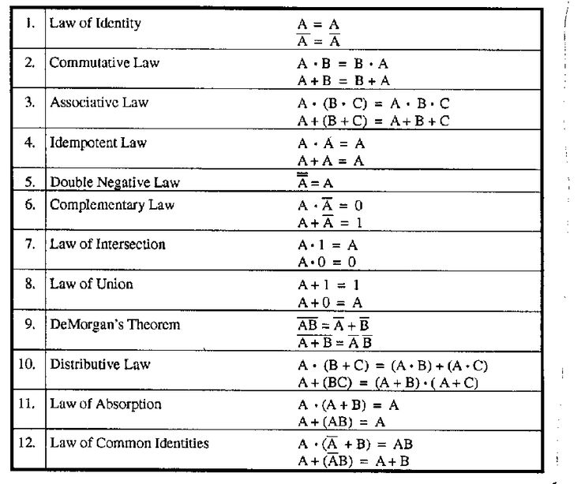



Simplifying logic gate
Boolean Algebra rules
De Morgan's theorem
$$\overline{A+B}=\overline{A}\overline{B}$$
$$\overline{AB}=\overline{A}+\overline{B}$$
XOR equivalent
$$A⊕B=\overline{A}B+A\overline{B}$$

Slide 45








Simplifying Logics gate
Example:1 Simplify the following logic
$$Y=\overset{̿}{AA}\overline{B}\overline{C}+\left(A+A\right)B\overline{C}+D\overline{E}+\overline{D}E+F\overline{F}\left(G+HI\right)$$
AA
A
A
0
$$Y=\overset{̿}{AA}\overline{B}\overline{C}+\left(A+A\right)B\overline{C}+D\overline{E}+\overline{D}E+F\overline{F}\left(G+HI\right)$$
$$Y=A\overline{B}\overline{C}+AB\overline{C}+D\overline{E}+\overline{D}E+(0)\left(G+HI\right)$$
$$Y=A\overline{B}\overline{C}+AB\overline{C}+D\overline{E}+\overline{D}E+(0)\left(G+HI\right)$$
0
$$Y=A\overline{B}\overline{C}+AB\overline{C}+D\overline{E}+\overline{D}E$$
$$Y=A\overline{C}(B+\overline{B})+D\overline{E}+\overline{D}E$$
1
$$Y=A\overline{C}(B+\overline{B})+D\overline{E}+\overline{D}E$$
$$Y=A\overline{C}(1)+D\overline{E}+\overline{D}E$$
$$Y=A\overline{C}+D\overline{E}+\overline{D}E$$
$$Y=A\overline{C}+D\overline{E}+\overline{D}E$$
$$D⊕E$$
$$Y=A\overline{C}+D⊕E$$

Slide 46


Simplifying logic gate
Example:2 Simplify the following logic
Example:3 Simplify the following logic
$$y=\overline{A}BC+ABC+\overline{B}C$$
$$Y=\left(\overline{A+B\overline{A}+\overline{A}\overline{B}}\right)+\left(\overline{A+\overline{B}}\right)$$

Slide 47
Sum-Over-Product (SOP) , Product-Over-Sum (POS) and K-Map

Slide 48
Sum-Over-Product (SOP) and Product-Over-Sum (POS)
Sum-Over-Product (SOP), Product-Over-Sum (POS) and K-map are 3 methods we can use to implement a Boolean expression from a truth table Both SOP and POS’s Boolean expression are not in its simplest form. SOP, POS and K-map can be use to implement a Boolean expression for any number of inputs correspond to one output

Slide 49


Sum-Over-Product (SOP) and Product-Over-Sum (POS)
Example:1 Write the Boolean Expression of the following truth table using Sum-Over-Product (SOP) and Product-Over-Sum (POS)
Inputs |  |  | Output
A | B | C | Y
0 | 0 | 0 | 0
0 | 0 | 1 | 0
0 | 1 | 0 | 1
0 | 1 | 1 | 0
1 | 0 | 0 | 1
1 | 0 | 1 | 0
1 | 1 | 0 | 1
1 | 1 | 1 | 1
Answers:
$$Y=\overline{A}B\overline{C}+A\overline{B}\overline{C}+AB\overline{C}+ABC$$
(SOP answer)
$$Y=(A+B+C)(A+B+\overline{C})(A+\overline{B}+\overline{C})(\overline{A}+B+\overline{C})$$
(POS answer)
*NOTE Although we get a Boolean expression using SOP and POS but it is not in is simplest form. We still can simply it further.

Slide 50





Sum-Over-Product (SOP) and Product-Over-Sum (POS)
SUM-OVER-PRODUCT (SOP)
Inputs |  |  | Output
A | B | C | Y
0 | 0 | 0 | 0
0 | 0 | 1 | 0
0 | 1 | 0 | 1
0 | 1 | 1 | 0
1 | 0 | 0 | 1
1 | 0 | 1 | 0
1 | 1 | 0 | 1
1 | 1 | 1 | 1
For SOP, we look at the inputs state that correspond to a logic HIGH output and AND them together. For those inputs that are logic LOW, we will invert them before we AND them
To get the Boolean expression, we OR those AND expression together as shown
$$\overline{A}B\overline{C}$$
$$A\overline{B}\overline{C}$$
$$AB\overline{C}$$
$$ABC$$
$$Y=\overline{A}B\overline{C}+A\overline{B}\overline{C}+AB\overline{C}+ABC$$

Slide 51




Sum-Over-Product (SOP) and Product-Over-Sum (POS)
PRODUCT-OVER-SUM (POS)
$$A+B+C$$
Inputs |  |  | Output
A | B | C | Y
0 | 0 | 0 | 0
0 | 0 | 1 | 0
0 | 1 | 0 | 1
0 | 1 | 1 | 0
1 | 0 | 0 | 1
1 | 0 | 1 | 0
1 | 1 | 0 | 1
1 | 1 | 1 | 1
For POS, we look at the inputs state that correspond to a logic LOW output and OR them together. For those inputs that are logic HIGH, we will invert them before we AND them
To get the Boolean expression, we AND those OR expression together as shown
$$A+B+\overline{C}$$
$$A+\overline{B}+\overline{C}$$
$$\overline{A}+B+\overline{C}$$
$$Y=(A+B+C)(A+B+\overline{C})(A+\overline{B}+\overline{C})(\overline{A}+B+\overline{C})$$

Slide 52
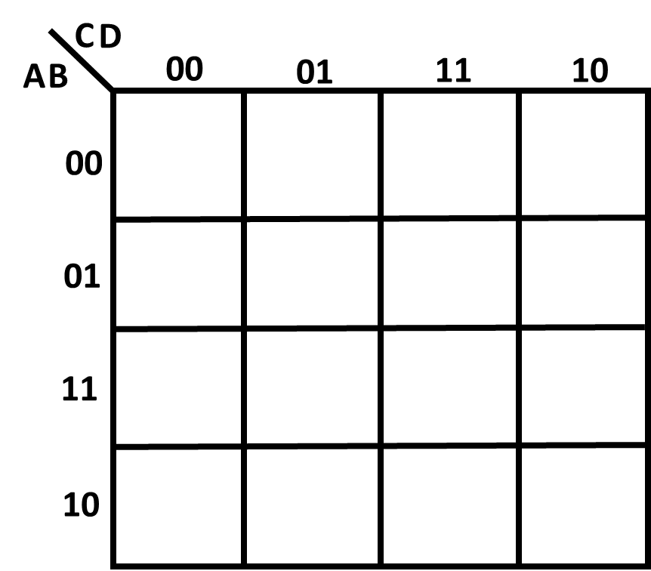
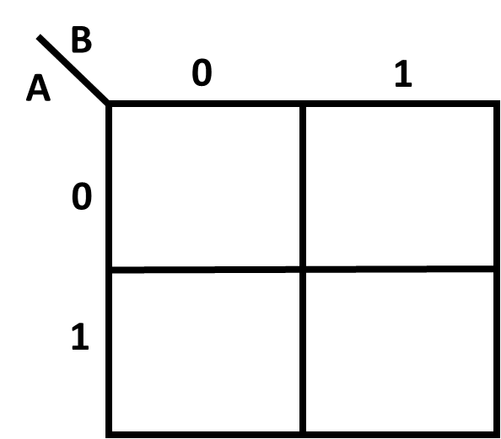
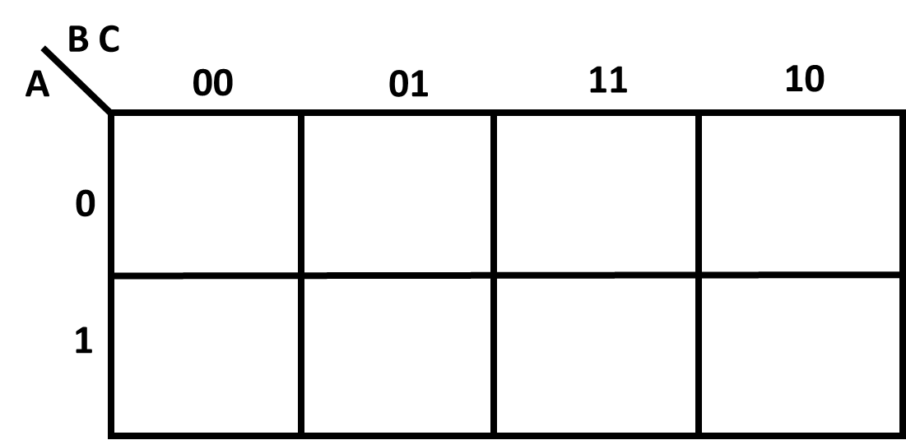
K-Maps (Karnaugh map)
K-Maps (Karnaugh map) can be use to implement a Boolean expression in its simplest form.
Below shows a K-map for 2 inputs, 3 inputs and 4 inputs
2 inputs K-map
3 inputs K-map
4 inputs K-map

Slide 53

K-Maps (Karnaugh map)
Example:2 Write the Boolean Expression for the following truth table using a K-map
Inputs |  | Output
A | B | Y
0 | 0 | 1
0 | 1 | 1
1 | 0 | 0
1 | 1 | 0
Answer:
$$Y= \overline{A}$$

Slide 54
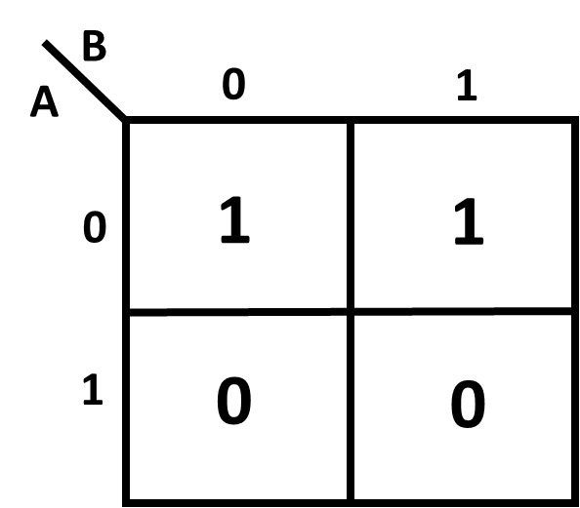
K-Maps (Karnaugh map)
Step 1
Copy the logic values of the output to the corresponding inputs on the K-map
Inputs |  | Output
A | B | Y
0 | 0 | 1
0 | 1 | 1
1 | 0 | 0
1 | 1 | 0

Slide 55
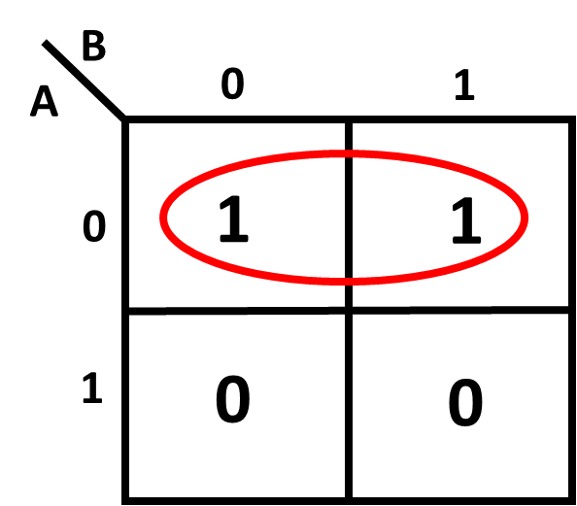
K-Maps (Karnaugh map)
Step 2
Group the ones together in groups of 2, 4, 8 or 16 as shown

Slide 56

K-Maps (Karnaugh map)
Step 3
For each group, AND the input(s) that is common to the group. If the input is logic LOW, Invert it before AND them
A in logic LOW is common to the group
Hence the Boolean expression is $\overline{A}$

Slide 57


K-Maps (Karnaugh map)
Step 4
OR all the groups Boolean expression
Since there is only one group which Boolean expression is $\overline{A}$ , The
Boolean expression for the Truth Table is
$$Y= \overline{A}$$

Slide 58

K-Maps (Karnaugh map)
Example:3 Write the Boolean Expression for the following truth table using a K-map
Inputs |  |  | Output
A | B | C | Y
0 | 0 | 0 | 0
0 | 0 | 1 | 0
0 | 1 | 0 | 1
0 | 1 | 1 | 0
1 | 0 | 0 | 1
1 | 0 | 1 | 0
1 | 1 | 0 | 1
1 | 1 | 1 | 1
Answer:
$$Y=A\overline{B}\overline{C}+AB+B\overline{C}$$

Slide 59
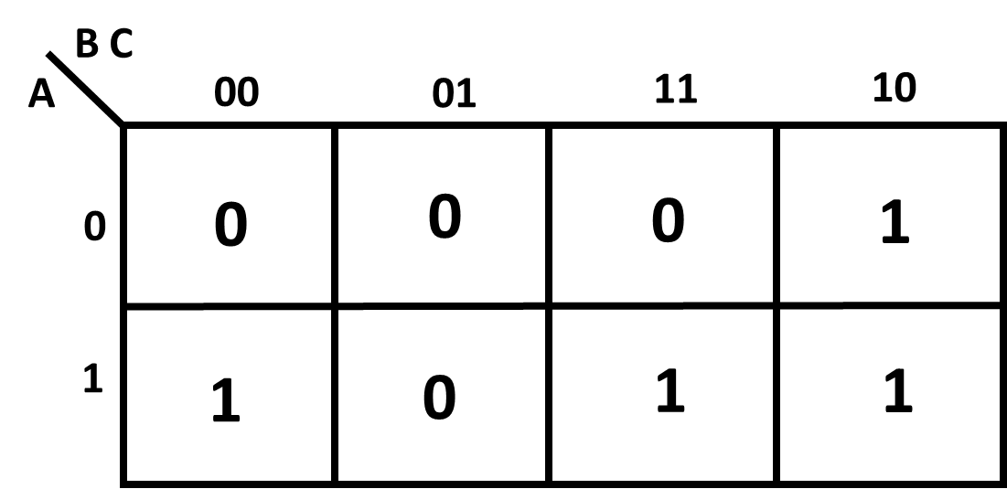
K-Maps (Karnaugh map)
Step 1
Copy the logic values of the output to the corresponding inputs on the K-map
Inputs |  |  | Output
A | B | C | Y
0 | 0 | 0 | 0
0 | 0 | 1 | 0
0 | 1 | 0 | 1
0 | 1 | 1 | 0
1 | 0 | 0 | 1
1 | 0 | 1 | 0
1 | 1 | 0 | 1
1 | 1 | 1 | 1

Slide 60
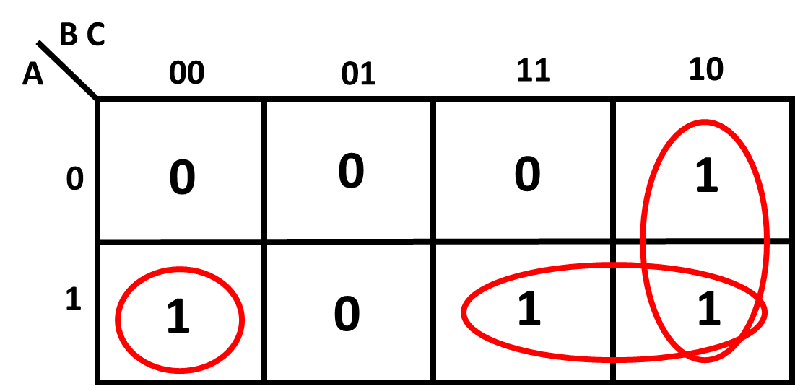
K-Maps (Karnaugh map)
Step 2
Group the ones together in groups of 2, 4, 8 or 16 as shown. Groups can overlap with each other

Slide 61
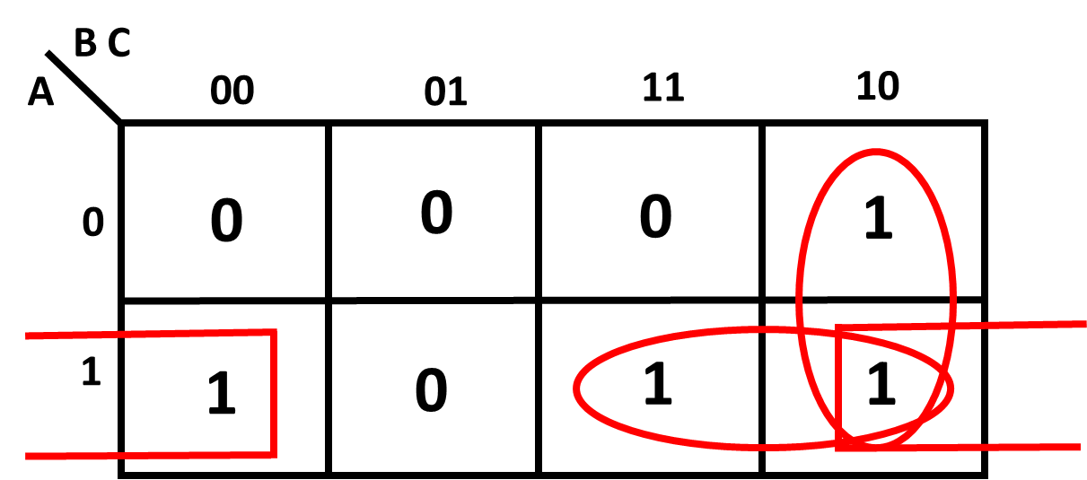



K-Maps (Karnaugh map)
Step 3
For each group, AND the input(s) that is common to the group. If the input is logic LOW, Invert it before AND them
$$B\overline{C}$$
$$A\overline{C}$$
$$AB$$

Slide 62




K-Maps (Karnaugh map)
Step 4
OR all the groups Boolean expression
$$B\overline{C}$$
$$Y=A\overline{C}+AB+B\overline{C}$$
$$A\overline{C}$$
$$AB$$

Slide 63

Inputs |  |  |  | Output
A | B | C | D | Y
0 | 0 | 0 | 0 | 0
0 | 0 | 0 | 1 | 0
0 | 0 | 1 | 0 | 0
0 | 0 | 1 | 1 | 1
0 | 1 | 0 | 0 | 1
0 | 1 | 0 | 1 | 1
0 | 1 | 1 | 0 | 0
0 | 1 | 1 | 1 | 1
1 | 0 | 0 | 0 | 0
1 | 0 | 0 | 1 | 0
1 | 0 | 1 | 0 | 1
1 | 0 | 1 | 1 | 1
1 | 1 | 0 | 0 | 0
1 | 1 | 0 | 1 | 0
1 | 1 | 1 | 0 | 0
1 | 1 | 1 | 1 | 1
Example:4 Write the Boolean Expression of the following truth table using a K-map
Answer:
$$Y=\overline{A}B\overline{C}+A\overline{B}C+CD$$

Slide 64
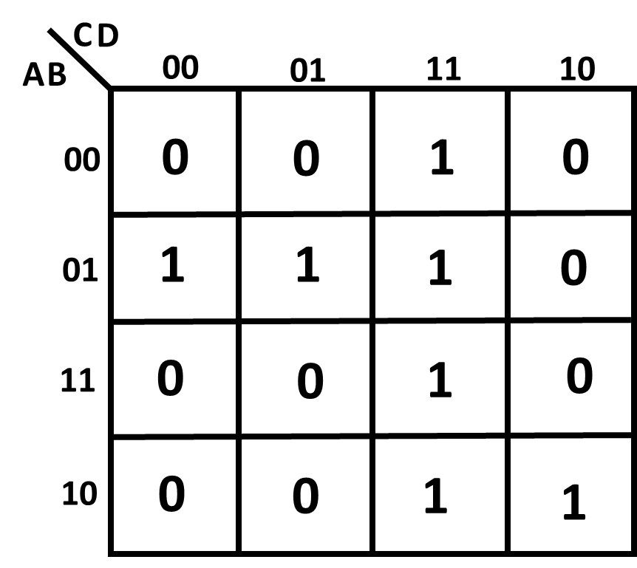
Inputs |  |  |  | Output
A | B | C | D | Y
0 | 0 | 0 | 0 | 0
0 | 0 | 0 | 1 | 0
0 | 0 | 1 | 0 | 0
0 | 0 | 1 | 1 | 1
0 | 1 | 0 | 0 | 1
0 | 1 | 0 | 1 | 1
0 | 1 | 1 | 0 | 0
0 | 1 | 1 | 1 | 1
1 | 0 | 0 | 0 | 0
1 | 0 | 0 | 1 | 0
1 | 0 | 1 | 0 | 1
1 | 0 | 1 | 1 | 1
1 | 1 | 0 | 0 | 0
1 | 1 | 0 | 1 | 0
1 | 1 | 1 | 0 | 0
1 | 1 | 1 | 1 | 1
Step 1
Copy the logic values of the output to the corresponding inputs on the K-map

Slide 65
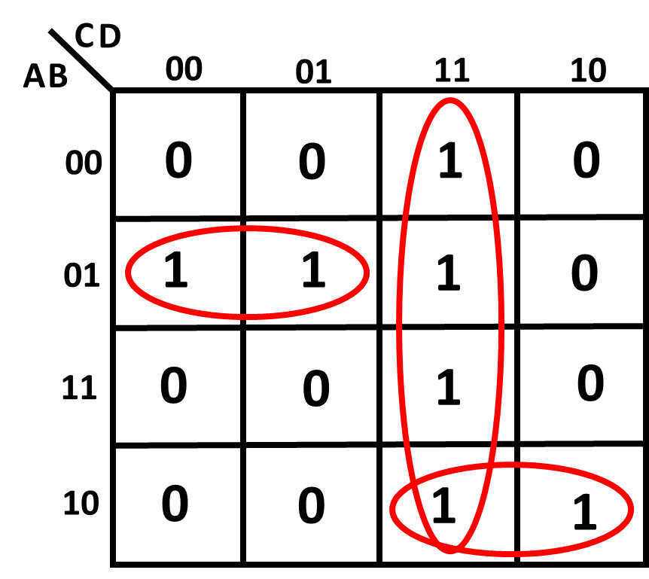
K-Maps (Karnaugh map)
Step 2
Group the ones together in groups of 2, 4, 8 or 16 as shown. Groups can overlap with each other

Slide 66



K-Maps (Karnaugh map)
Step 3
For each group, AND the input(s) that is common to the group. If the input is logic LOW, Invert it before AND them
$$CD$$
$$\overline{A}B\overline{C}$$
$$A\overline{B}C$$

Slide 67
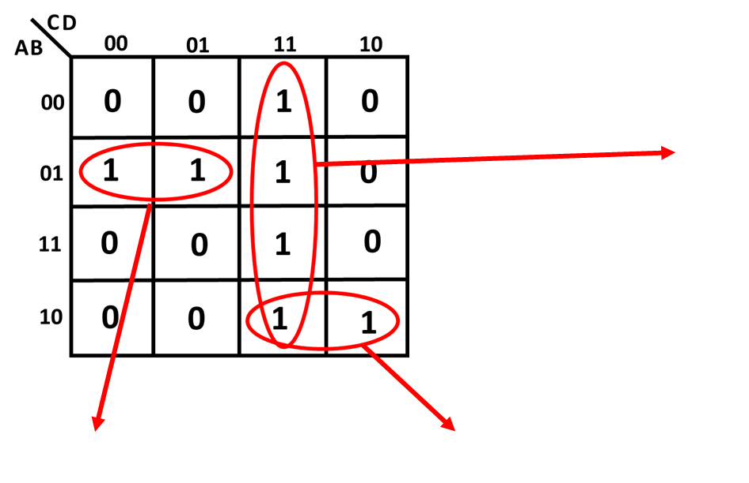

K-Maps (Karnaugh map)
Step 4
OR all the groups Boolean expression
$$Y=\overline{A}B\overline{C}+A\overline{B}C+CD$$

Slide 68
The END

